Slide 1
01 / 07
MSE803 · DATA ANALYTICS
Data Cleaning &
Visualization
Pearson Correlation Heatmap · Outlier Detection
Week 3 · Activity 2

Slide 2
DATASET OVERVIEW
02 / 7
Raw Data Issues at a Glance
8
1
1
Duplicate row
Bob (ID=2) split across two rows
Text numbers
Missing
Values
Duplicate
Row
Invalid
Date
"thirty-eight" · "sixty five thousand"
Missing values
Age ×2 · Salary ×2 · ID, Name, Country ×1
File messy_dataset_Mukesh.csv Rows 10 Columns 6 Fields ID · Name · Age · Country · Salary · Join Date
Invalid date
"2019-13-01" — month 13 doesn't exist
Country inconsistency
"AU" mixed with "AUS"
MSE803 Data Analytics · Week 3 Activity 2 · 2511-YCCIA-MSE

Slide 3
DATA CLEANING
03 / 7
Steps Applied to Fix the Dataset
Issue Found | Fix Applied
Duplicate Bob (ID=2) — 2 rows, split values | Merged: Age from row 1, Salary from row 2
"thirty-eight" / "sixty five thousand" | Converted to numeric: 38 / 65,000
Missing ID (Eve) | Assigned next available ID: 11
Invalid date "2019-13-01" (month 13) | Parsed as 2019-01-13 via %Y-%d-%m format
"AU" vs "AUS" inconsistency | Standardised all to "AUS"
Missing Age / Salary (Heidi) | Filled with column median: 29.5 / $62,000
Missing Name (row 7) | Replaced with "Unknown"
Missing Country (Grace) | Filled with mode: "NZ"
MSE803 Data Analytics · Week 3 Activity 2 · 2511-YCCIA-MSE

Slide 4
CLEANED DATA
04 / 7
Final Dataset — 9 Records, 0 Missing Values
ID | Name | Age | Country | Salary | Join Date
1 | Alice | 25 | NZ | $55,000 | 2020-01-15
2 | Bob | 30 | NZ | $60,000 | 2020-02-20
4 | Charlie | 35 | AUS | $72,000 | NaT
5 | David | 38 | NZ | $68,000 | 2019-11-01
11 | Eve | 29 | AUS | $59,000 | 2019-01-13
7 | Unknown | 40 | NZ | $65,000 | 2018-05-30
8 | Grace | 22 | NZ | $64,000 | 2021-07-25
9 | Heidi* | 29.5* | AUS | $62,000* | 2021-07-25
10 | Ivan | 27 | NZ | $58,000 | 2019-03-15
* Heidi's missing Age & Salary filled with column medians · NaT = no date in source data
MSE803 Data Analytics · Week 3 Activity 2 · 2511-YCCIA-MSE

Slide 5
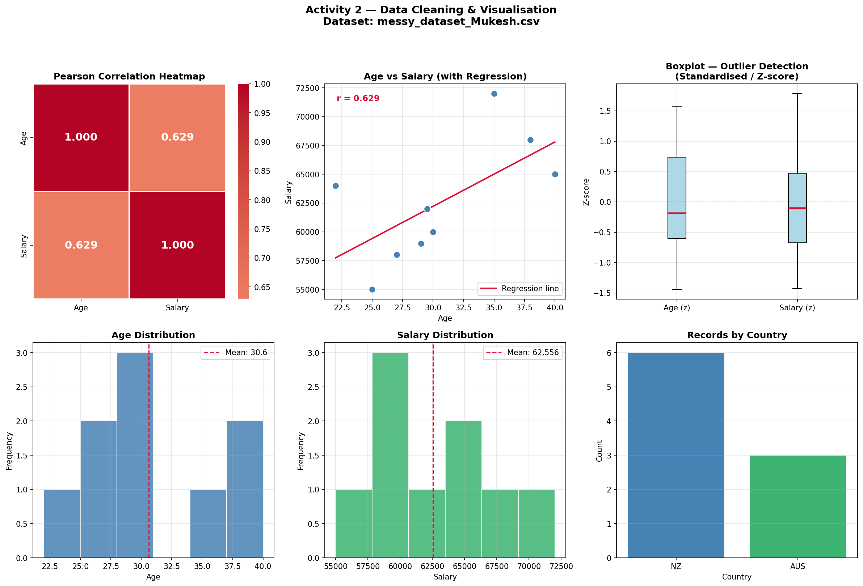
CORRELATION
05 / 7
Pearson Correlation Heatmap
r = 0.882
Strong Positive Correlation
Pearson Scale
r = +1.0
Perfect positive
r = 0.882
Strong positive ←
r = 0.0
No correlation
r = −1.0
Strong negative
MSE803 Data Analytics · Week 3 Activity 2 · 2511-YCCIA-MSE

Slide 6
OUTLIER DETECTION
06 / 7
IQR Method — No Outliers Detected
Age
Salary
Q1 (25th percentile)
27.0
Q1 (25th percentile)
$59,000
Q3 (75th percentile)
35.0
Q3 (75th percentile)
$65,000
IQR (Q3 − Q1)
8.0
IQR (Q3 − Q1)
$6,000
Lower bound (Q1 − 1.5×IQR)
15.0
Lower bound (Q1 − 1.5×IQR)
$50,000
Upper bound (Q3 + 1.5×IQR)
47.0
Upper bound (Q3 + 1.5×IQR)
$74,000
✓ No Outliers Detected
✓ No Outliers Detected
IQR rule: values outside [Q1 − 1.5×IQR, Q3 + 1.5×IQR] are flagged as outliers · Z-score boxplot on visualization panel also confirms clean bounds
MSE803 Data Analytics · Week 3 Activity 2 · 2511-YCCIA-MSE

Slide 7
Summary & Key Insights
07 / 07
9
0.882
NZ
Issues Cleaned
Pearson r
Dominant Country
Duplicates, text values, missing fields & dates
Strong positive correlation — Age ↑ Salary ↑
6 of 9 employees based in New Zealand
0
22–40
≠
Outliers Found
Age Range
Correlation ≠ Causation
IQR confirms clean bounds for Age & Salary
Salary range: $55,000 – $72,000
Trend observed but no causal claim made
Thank you · MSE803 Data Analytics · Week 3 Activity 2 · 2511-YCCIA-MSE

